Slide 1

Text emotional classification – LLM

Slide 2

Project Leadership
Sharat Manikonda
Director at Innodatatics and Sponsor
linkedin.com/in/sharat-chandra

Slide 3
Team Members
Name: Sugumar .S

Slide 4

Contents
Business objective
Business Constraints
Project Architecture
Data collection and details
Exploratory Data Analysis
Visualization
Modeling
Evaluation
Deployment
Notes:
Change

Slide 5
Project Overview and Scope
For this project, I implemented a Modular NLP Text Classification Pipeline, specifically utilizing Architecture E. This architecture was selected for its flexibility and efficiency in managing diverse text classification tasks. Its modular design facilitates easy integration, customization, and scalability of various NLP components. This setup enables detailed analysis of emotions, grammar, filler words, and the usage of formal and informal words, ensuring robust performance and adaptability across different datasets and use cases.

Slide 6
Business Problem
The business problem we are addressing is that candidates often lose job opportunities due to their poor English language skills and inadequate expression of emotions. This issue affects their ability to communicate effectively during interviews and in professional settings. As a result, even qualified individuals are frequently overlooked by employers. Our goal is to provide a solution that enhances their language proficiency and emotional expressiveness, improving their chances of securing employment.

Slide 7
Business Objective
Objective
Constraints
The business objective is to analyze various aspects of communication, including emotions, grammar, filler words, and the use of formal and informal language. This analysis aims to identify and address specific areas where candidates may struggle. By providing detailed feedback and insights, we can help improve their communication skills. Ultimately, this will enhance their ability to perform better in professional settings and increase their chances of securing job opportunities.
The business constraint is to maximize manual effort within the project. This involves leveraging human expertise and intervention as much as possible throughout the process. The goal is to ensure high-quality analysis and personalized feedback by utilizing manual methods.

Slide 8
CRISP-ML(Q) Methodology
There are six stages of CRISP-ML(Q) Methodology
1.Business and data understanding
2.Data preparation
3.model building
4.Model evaluation
5.Model deployment
6.Monitoring and maintenance

Slide 9
Technical Stacks
For the Text Emotional Classification – LLM project, we trained five large language models (LLMs) and two custom models. Based on these models, we created a technical document for predicting formal and informal text. This technical document includes seven models: Gemini, Palm2, Gemma, Lama2, Lama3, and the two custom models, BERT and RoBERTa.
In this document, each model features three columns: "Text" (the original data), "Actual Text" (also the original data), and "Predicted Text" (the text as predicted by the models). Each feature contains 20 records. If the data is informal, these models convert it into formal text.

Slide 10
Data Collection and Understanding
For the Text Emotional Classification – LLM project, I collected several datasets from sources such as Kaggle and GitHub. For emotion classification, the datasets used included the SemEval 2019 Dataset, ISEAR Dataset, GoEmotions Dataset, Stanford Sentiment Treebank Dataset, Emotion Capture Dataset, and Sentiment Analysis Dataset. For formal and informal text analysis, the GYAFC Dataset, Stanford Politeness Corpus, Style Transfer Dataset, SubTle Corpus, Enron Email Dataset, and COCA Dataset were utilized. For grammar mistakes, the Spanish_Grammars Dataset and JFLEG Corpus were used. For filler words, the Switchboard Corpus, CSJ Dataset, Santa Barbara Corpus, and Buckeye Speech Corpus were included.
These datasets were in various formats, including Excel, JSON, text, Python (.py), and Jupyter Notebook (.ipynb). Due to the large size of these datasets, substantial computational power was required for model training. For emotion classification, I trained models using the Sentiment Analysis Dataset. However, for formal and informal text classification, I was unable to train with large datasets. Instead, I manually collected 350 records and used them to train the models.

Slide 11
Data Information
The Tweet Sentiment Analysis Dataset contains tweets with their corresponding sentiment, author, and content. It can be used to analyze and understand the sentiment of tweets and to develop machine learning models for sentiment analysis. The dataset includes columns for tweet_id, sentiment, author, and content, providing a comprehensive view of each tweet. This dataset can be used in various applications such as sentiment analysis, natural language processing, and social media analysis.Another dataset, the Formal and Informal Text Classification Dataset, contains text data manually collected from various sources. This dataset consists of two variables: text and labels. The text column represents the text content, while the labels column indicates whether the text is formal or informal. This dataset can be used to train machine learning models to classify text as formal or informal, which can be useful in applications such as language processing, content moderation, and educational tools.

Slide 12
Data Dictionary
Tweet Sentiment Analysis Dataset
Column | Description
tweet_id | Unique identifier for each tweet
sentiment | The sentiment of the tweet, which can be positive, negative, or neutral
author | The author of the tweet
content | The text content of the tweet
Formal and Informal Text Classification Dataset
Column | Description
text | The text content, which can be formal or informal
labels | Indicates whether the text is formal (1) or informal (0)

Slide 13
Data Preprocessing
To prepare the Formal and Informal Text Classification Dataset and Tweet Sentiment Analysis Dataset for analysis, I performed several preprocessing steps. First, I dropped any unwanted features from the datasets to improve efficiency and accuracy. Next, I used label encoding to convert categorical labels into numerical values, making it easier for the models to understand and process. I then employed regular expressions to remove any special characters from the text data, ensuring that the models only focus on the relevant information. Additionally, I used Python functions to convert all text to lowercase, which helps to reduce the impact of capitalization on the models' performance. Finally, I applied appropriate tokenization techniques to each dataset, breaking down the text into individual words or tokens that can be analyzed by the models.
Notes:
Keep observations

Slide 14
Model Building
For the Text Emotional Classification - LLM project, I built two custom models, Bert and Roberta, and five large language models (LLMs), Gemini, Palm2, Gemma, Lama3, and Lama2. For the custom models, I utilized public datasets and custom datasets, while for the LLMs, I crafted proper prompts to elicit the required outputs. After constructing the models, I conducted an evaluation of the seven models, which fortunately yielded good accuracy for emotion classification and formal and informal prediction. Here are the key points:
• Custom Models: Bert and Roberta were trained on public datasets and custom datasets.
• LLMs: Gemini, Palm2, Gemma, Lama3, and Lama2 were trained with proper prompts.
• Evaluation: All seven models demonstrated good accuracy for emotion classification and formal and informal prediction.
• Key Findings: The results showed that both custom models and LLMs can effectively classify text emotions and predict formal and informal language.
.
Notes:
classification is the task of predicting a discrete class label. Regression is the task of predicting a continuous quantity.
What is classification techniques in machine learning?
The Classification algorithm is a Supervised Learning technique that is used to identify the category of new observations on the basis of training data. In Classification, a program learns from the given dataset or observations and then classifies new observation into several classes or groups.
What is regression techniques in machine learning?
Regression is a technique for investigating the relationship between independent variables or features and a dependent variable or outcome. It's used as a method for predictive modeling in machine learning, in which an algorithm is used to predict continuous outcomes.

Slide 15
Model Accuracy Comparison
For the Text Emotional Classification - LLM project, I built two custom models, Bert and Roberta, and evaluated their performance using various metrics. The evaluation metrics for the custom models are as follows: Roberta achieved an accuracy of 0.600000 for formal and informal prediction, with a training loss of 0.344743 and a validation loss of 0.600000. Bert also achieved an accuracy of 0.600000 for formal and informal prediction, with a training loss of 0.105079 and a validation loss of 0.600000. Additionally, Roberta achieved an accuracy of 0.316000 for emotion classification after 8 epochs, while Bert achieved an accuracy of 0.358000 after 3 epochs. For LLMs, Palm2 demonstrated impressive performance in emotion classification, with an accuracy of 0.67, precision of 0.67, recall of 0.67, and F1 score of 0.67.
.

Slide 16
Model Deployment - Strategy
For the Text Emotional Classification - LLM project, I developed two custom models and five large language models (LLMs). For the custom models, I loaded the saved SafeTensor models and their corresponding tokens. For the LLMs, I utilized three files: app.py, which contains the Streamlit code; model.py, which contains the model code; and requirements.txt, which lists the required dependencies.To facilitate the interaction between the models and the user, I created a Streamlit application with an interface that includes one input edit box and five buttons, each corresponding to a specific business objective. After entering the text, users can click the "Emotion Classification" button to classify the emotions in the input text. This is followed by the option to click the "Grammar Correction" button, "Filler Words Detection" button, "Convert to Formal" button, and "Analyze Sentiment" button to perform these respective operations.

Slide 17
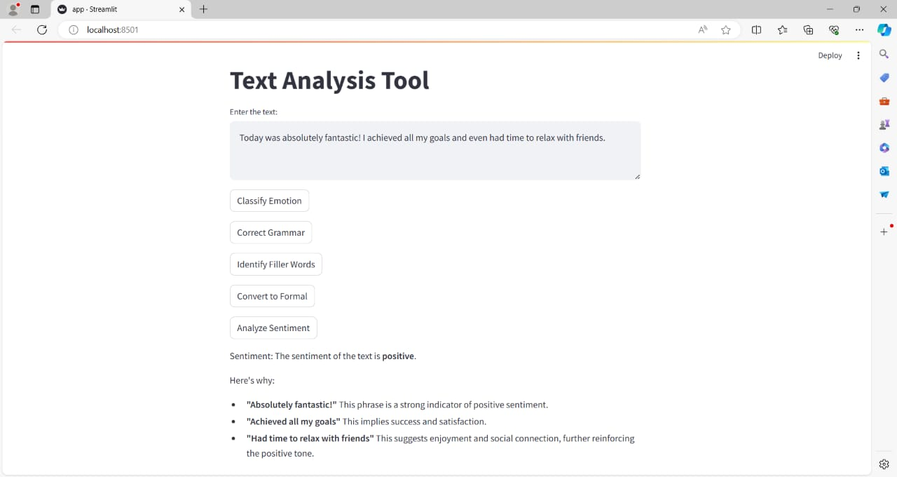
Screen shot of output

Slide 18
Challenges
For the Text Emotional Classification - LLM project, I encountered several challenges while collecting the appropriate datasets. Specifically, the emotion classification objective posed difficulties in selecting the most suitable datasets, as it required a comprehensive set of emotions such as Disheartening, Worried, Curious, Surprised, Formal, Assertive, Confident, Appreciative, Concerned, Informal, Regretful, Encouraging, Egocentric, Joyful, Optimistic, and Excited. This necessitated a thorough search for the most relevant datasets.During the training process, the custom models required significant computational power, which necessitated the use of a GPU. To address this challenge, I explored various options, including the use of cloud platforms and free resources like Google Colab. Additionally, I encountered version mismatch errors with certain NLP libraries, which consumed more time than other aspects of the project.

Slide 19
Future Scopes
For the Text Emotional Classification - LLM project, the future scope includes:
• Improved Sentiment Analysis: Enhance the model's ability to accurately identify and classify emotions in text, enabling more precise sentiment analysis and better decision-making.
• Enhanced Grammar Correction: Develop a more sophisticated grammar correction system that can effectively identify and correct grammatical errors in text, improving overall text quality.
• Advanced Filler Word Detection: Improve the model's ability to detect and remove filler words, enhancing the clarity and effectiveness of text.
• Formal and Informal Language Identification: Develop a more accurate system for identifying formal and informal language, enabling better categorization and analysis of text.

Slide 20

Queries ?

Slide 21


